Slide 1
Short-Range Communication Used in IoT
Vraj Suratwala
Department of ICT, VNSGU

Slide 2
WPAN
WPAN – Wireless Personal Area Network
WPAN is a wireless network designed for communication between devices within a short personal range.
Examples include communication between:
  Smartphone and smartwatch
  Sensors and a controller
  Wireless headphones and mobile phones
  IoT sensors and gateways
Important WPAN protocols used in IoT include:
  Bluetooth, Bluetooth Low Energy (BLE), ZigBee and ANT

Slide 3
1. Bluetooth
Bluetooth is a short-range wireless communication technology mainly designed for connecting personal devices.
Features:
  Short-range communication
  Wireless and cable-free
  Suitable for device-to-device communication
  Commonly used in smartphones, headphones, keyboards and other personal devices
  Generally consumes more power than BLE
Applications:
  Wireless headphones
  Mobile-to-device communication
  Keyboards and mice
  Personal devices

Slide 4
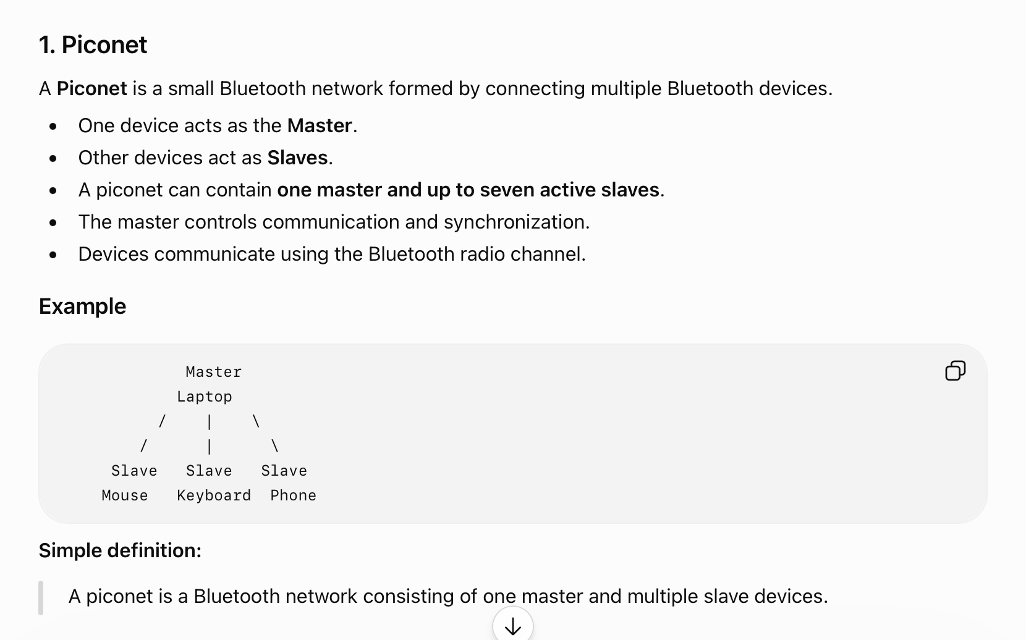

Slide 5
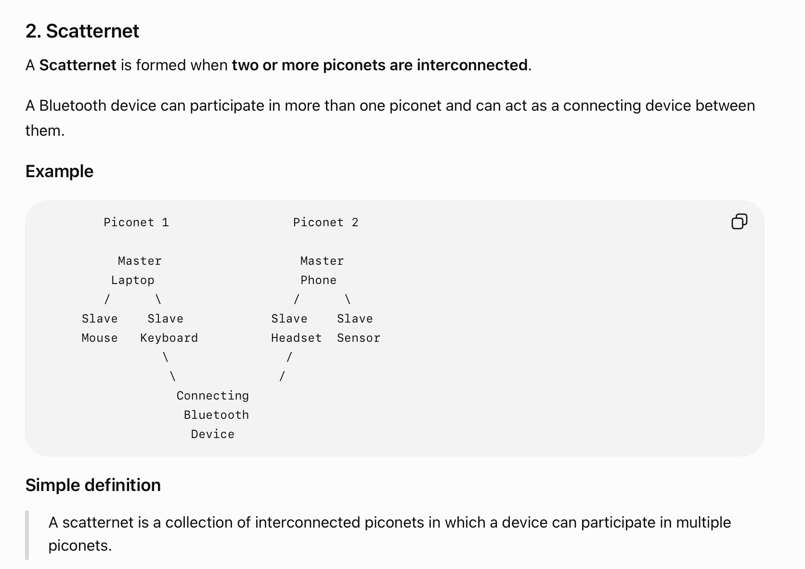

Slide 6
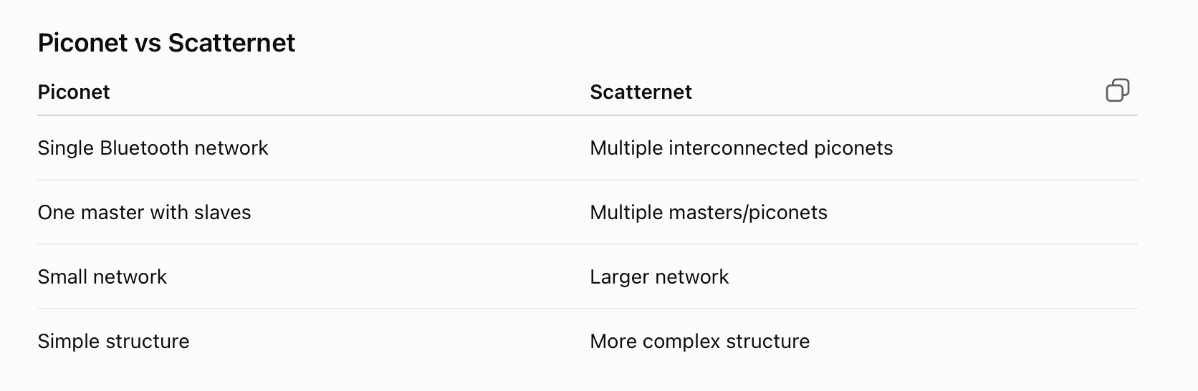

Slide 7
2. Bluetooth Low Energy (BLE)
BLE is a low-power version of Bluetooth designed particularly for devices that need to operate for a long time using batteries.
Features:
  Very low power consumption
  Short-range communication
  Suitable for small and periodic data transmission
  Supports battery-powered IoT devices
  Commonly used with smartphones
Applications:
  Fitness bands
  Smartwatches
  Health sensors
  Beacons
  Smart-home sensors
BLE operates in the 2.4 GHz ISM (Industrial, Scientific and Medical) band.
Easy Difference:
Bluetooth → General short-range communication
BLE → Low-power IoT and sensor communication

Slide 8
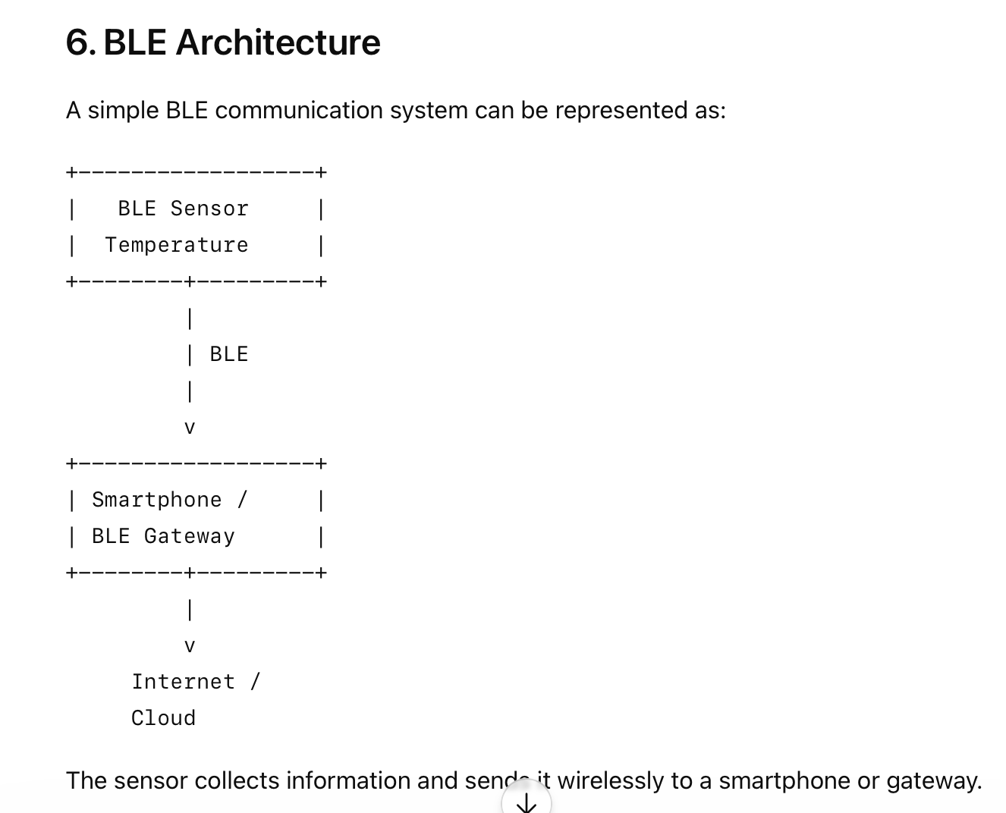

Slide 9
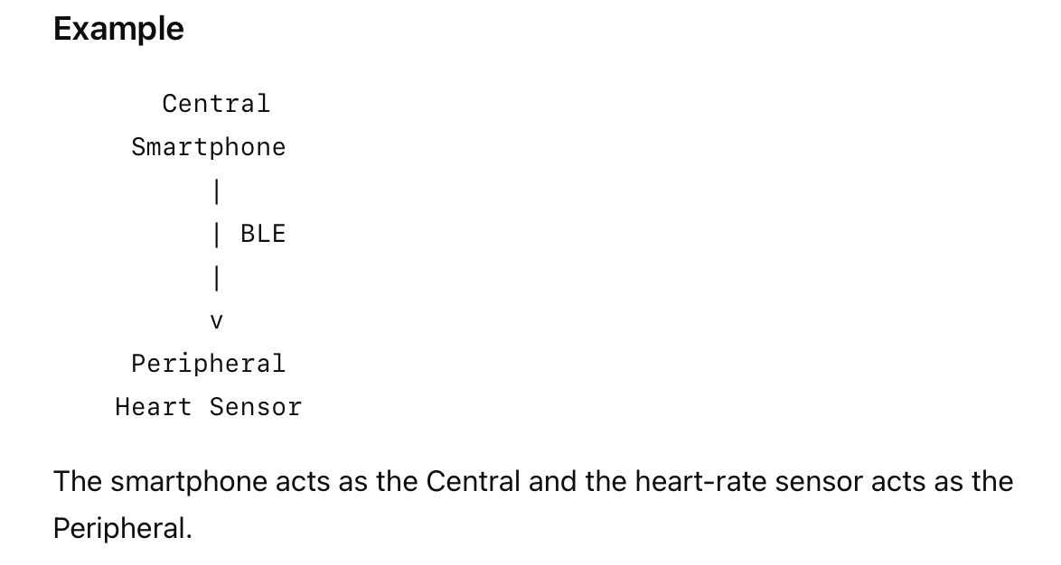
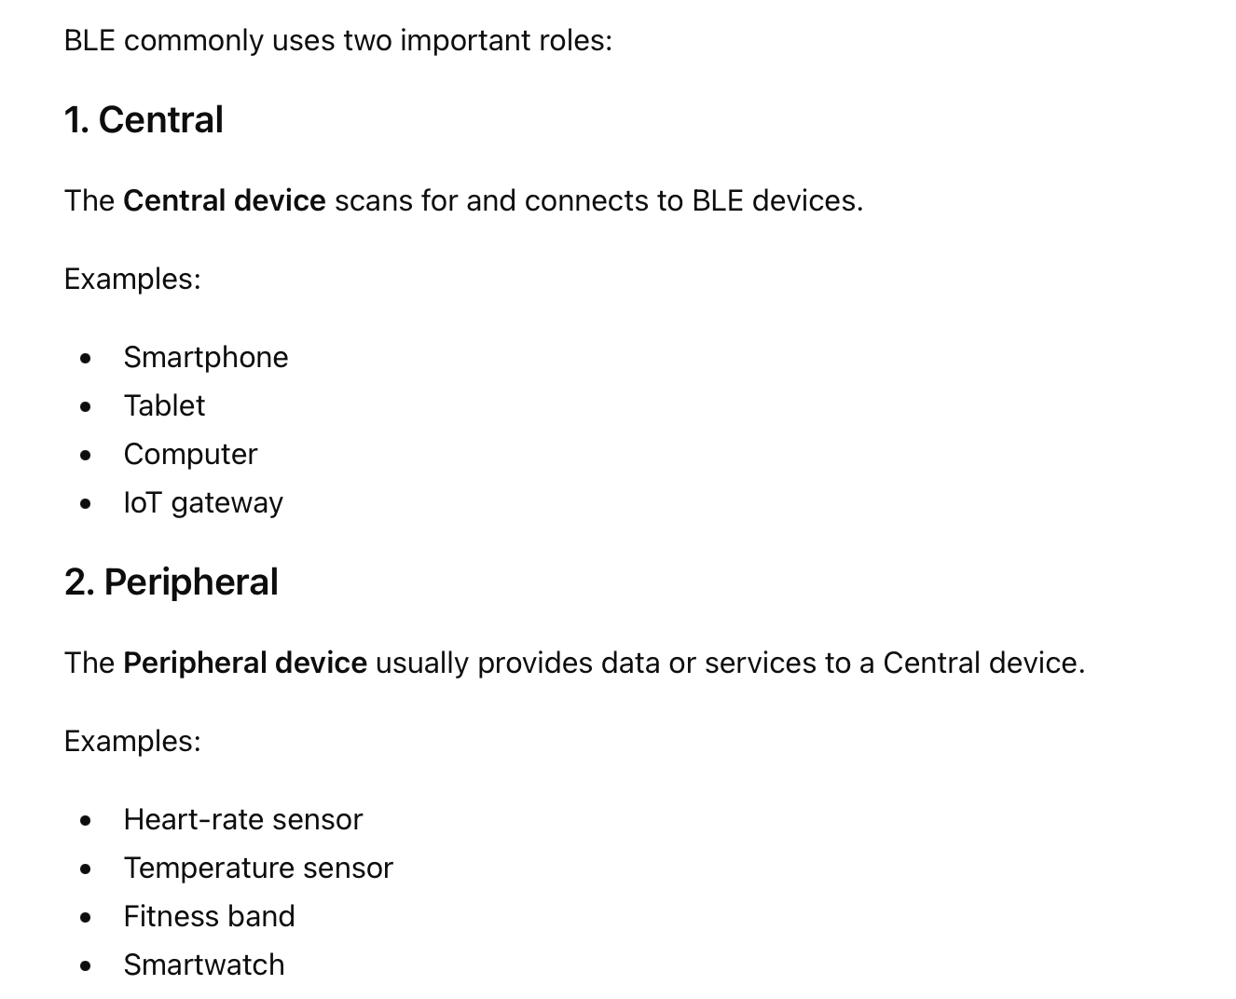
BLE Device Role

Slide 10
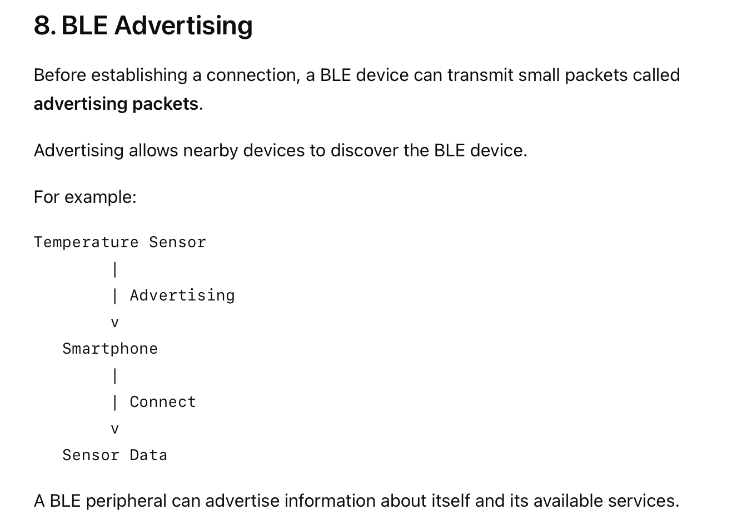

Slide 11
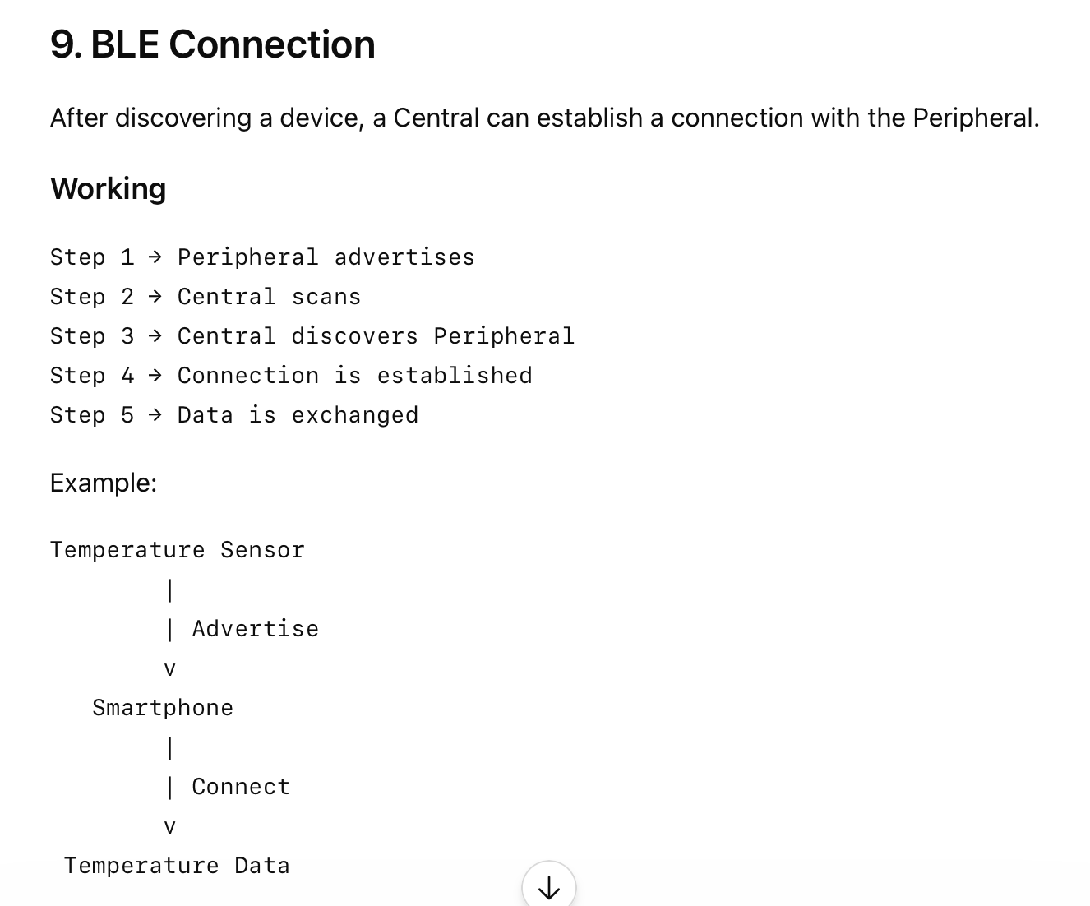
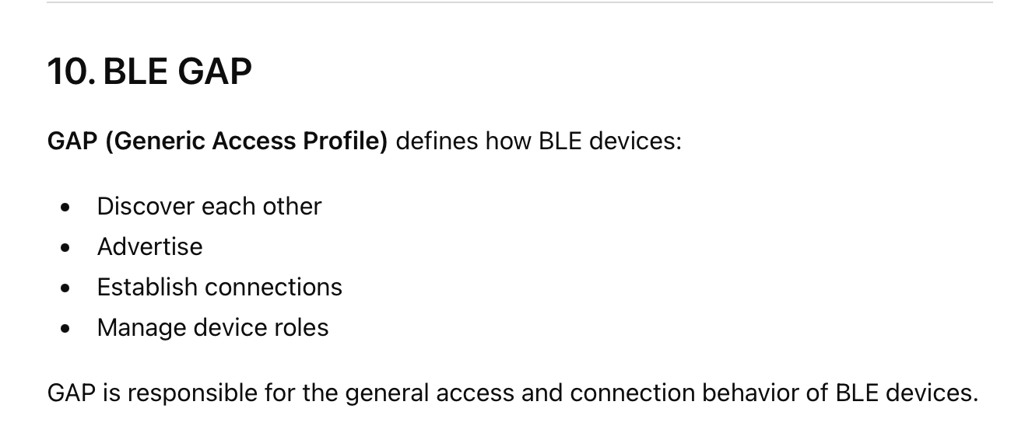

Slide 12
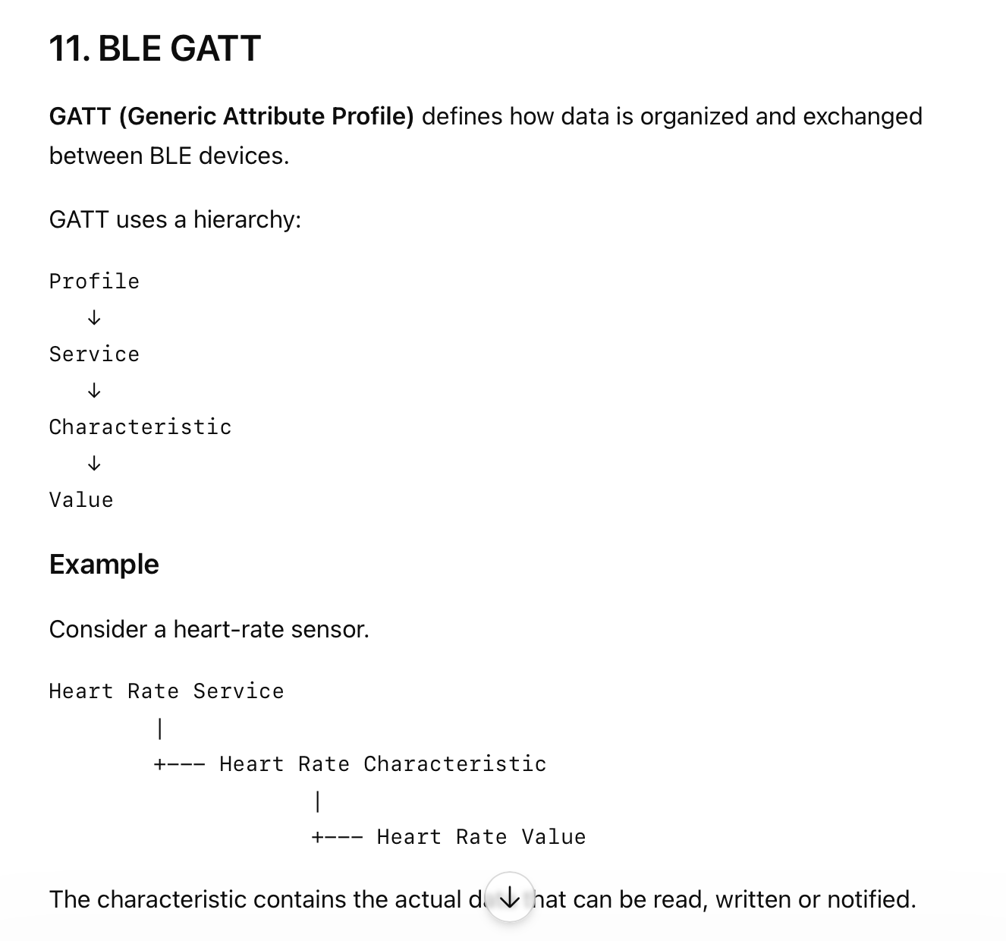
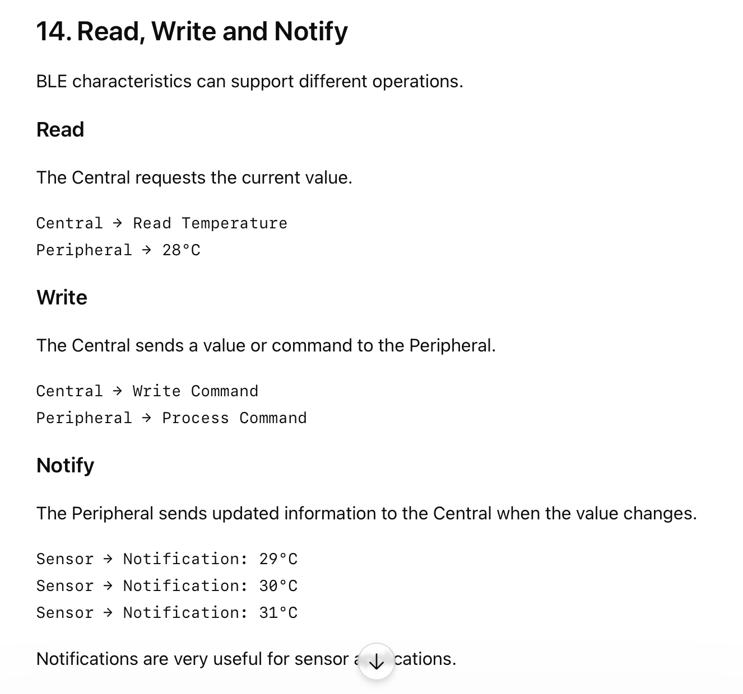

Slide 13
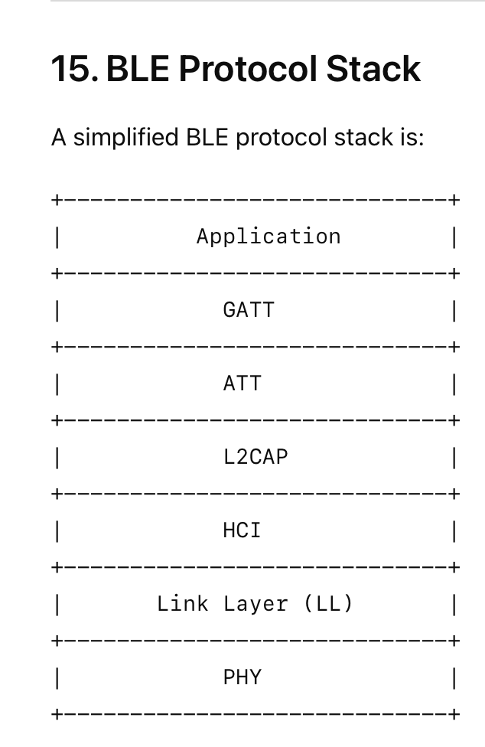
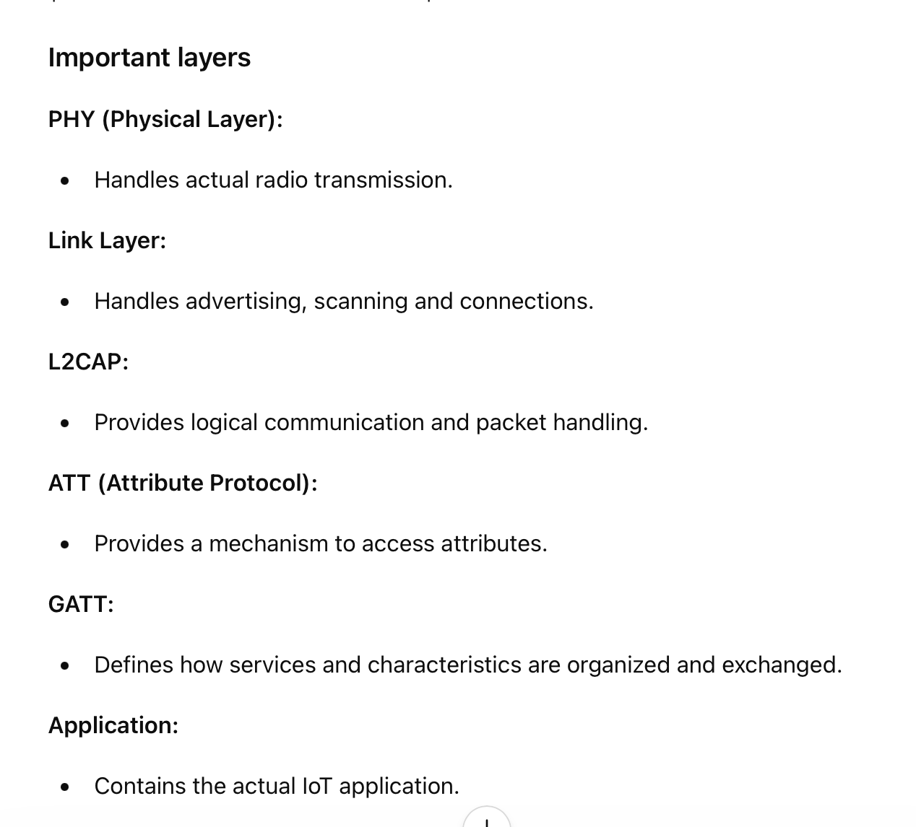

Slide 14
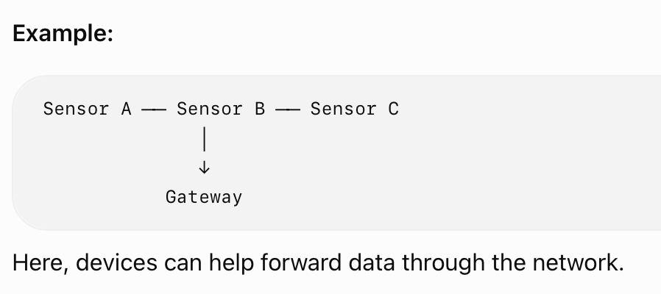
3. ZigBee
ZigBee is a low-power wireless communication technology designed for IoT and sensor networks.
One important feature of ZigBee is its ability to support mesh networking, where devices can communicate through other devices in the network.
Features:
  Low power consumption
  Suitable for sensor networks
  Supports mesh networks
  Can connect many devices
  Suitable for relatively low data-rate applications
Applications:
  Home automation
  Smart lighting
  Industrial monitoring
  Security systems
  Smart energy systems

Slide 15
ZigBee Device Types
ZigBee mainly has three types of devices:
1. ZigBee Coordinator (ZC)
  It is the main device of a ZigBee network.
  It starts and manages the network.
  There is normally one coordinator in a ZigBee network.
  It can store network information and security information.
2. ZigBee Router (ZR)
  It forwards data between devices.
  It extends the network coverage.
  It can communicate with other routers and end devices.
  It helps create a mesh network.
3. ZigBee End Device (ZED)
  It is a simple, low-power device.
  It usually communicates through a coordinator or router.
  It can enter sleep mode to save battery.
  Examples: temperature sensor, light sensor, motion sensor.

Slide 16
ZigBee Network Topologies
ZigBee supports mainly three network topologies:
Star Topology
Tree Topology
Mesh Topology

Slide 17
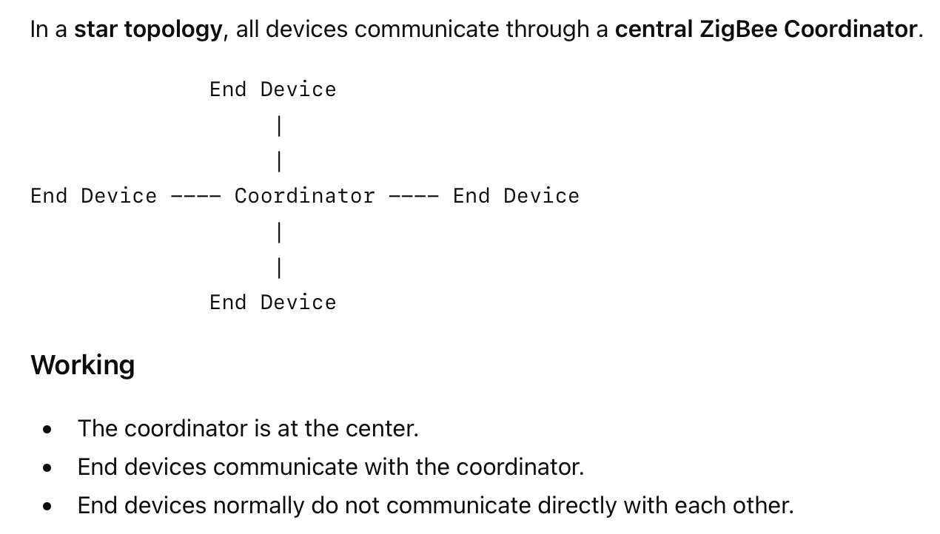
1. Star Topology

Slide 18
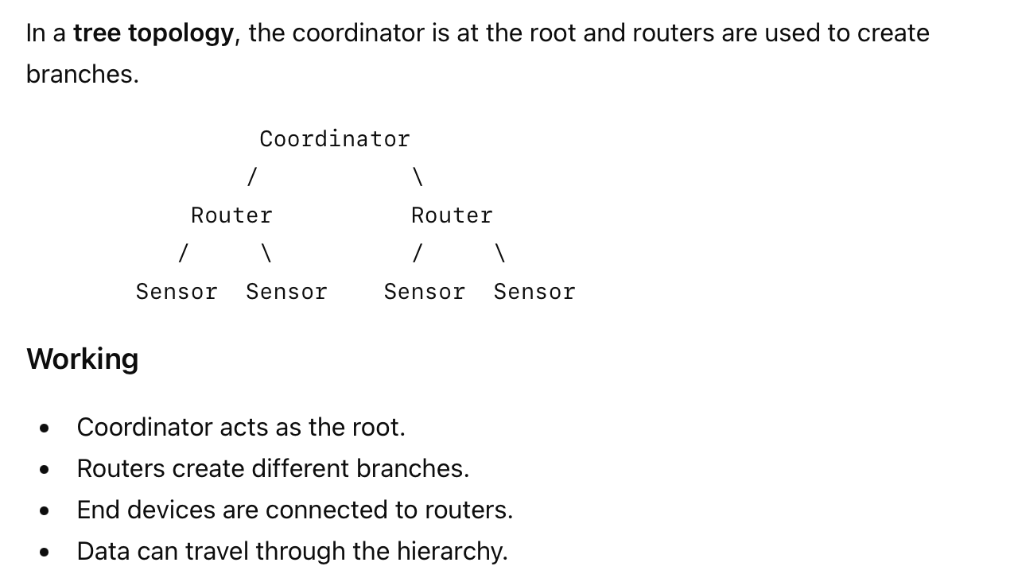
2. Tree Topology

Slide 19
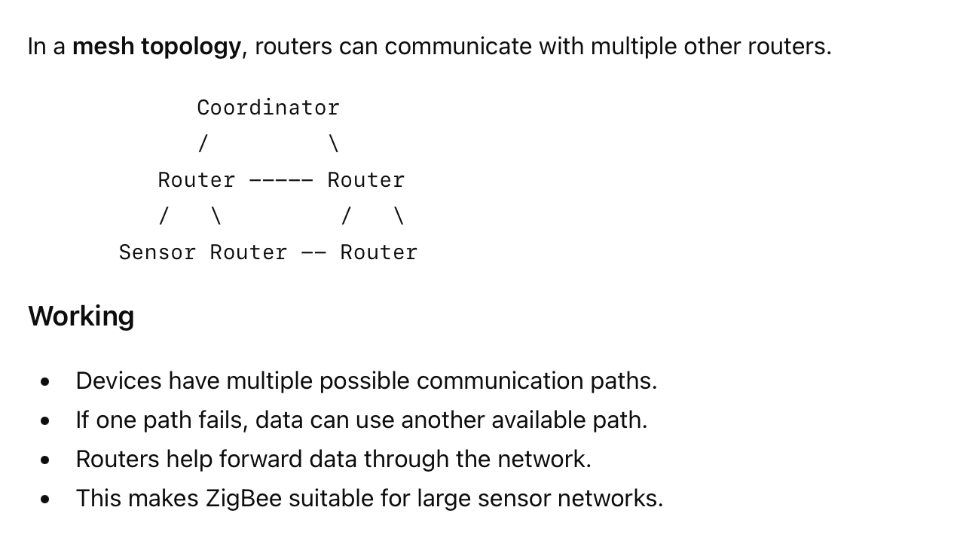
3. Mesh Topology

Slide 20
4. ANT
ANT is a low-power wireless communication protocol mainly used for monitoring and sensor-based applications.
It is particularly associated with sports, fitness and health devices.
Features:
  Low power consumption
  Short-range wireless communication
  Suitable for sensor data
  Supports communication between multiple devices
  Designed for applications requiring low data rates
Applications:
  Heart-rate monitors
  Cycling sensors
  Fitness equipment
  Sports monitoring
  Wearable devices

Slide 21
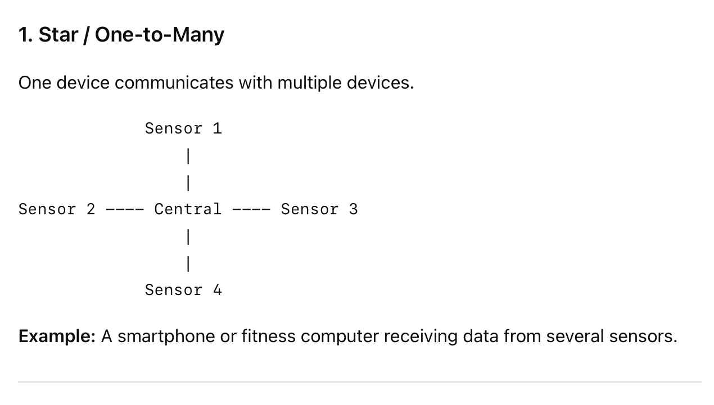
ANT Topology

Slide 22
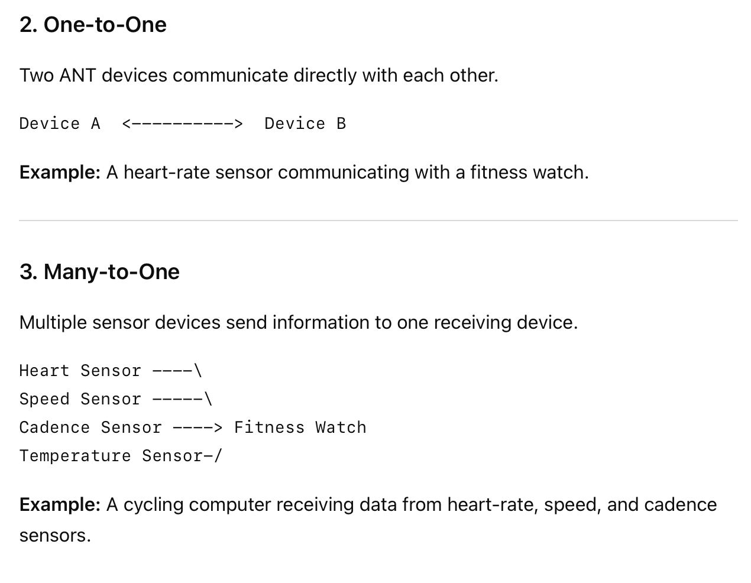
ANT Topology

Slide 23
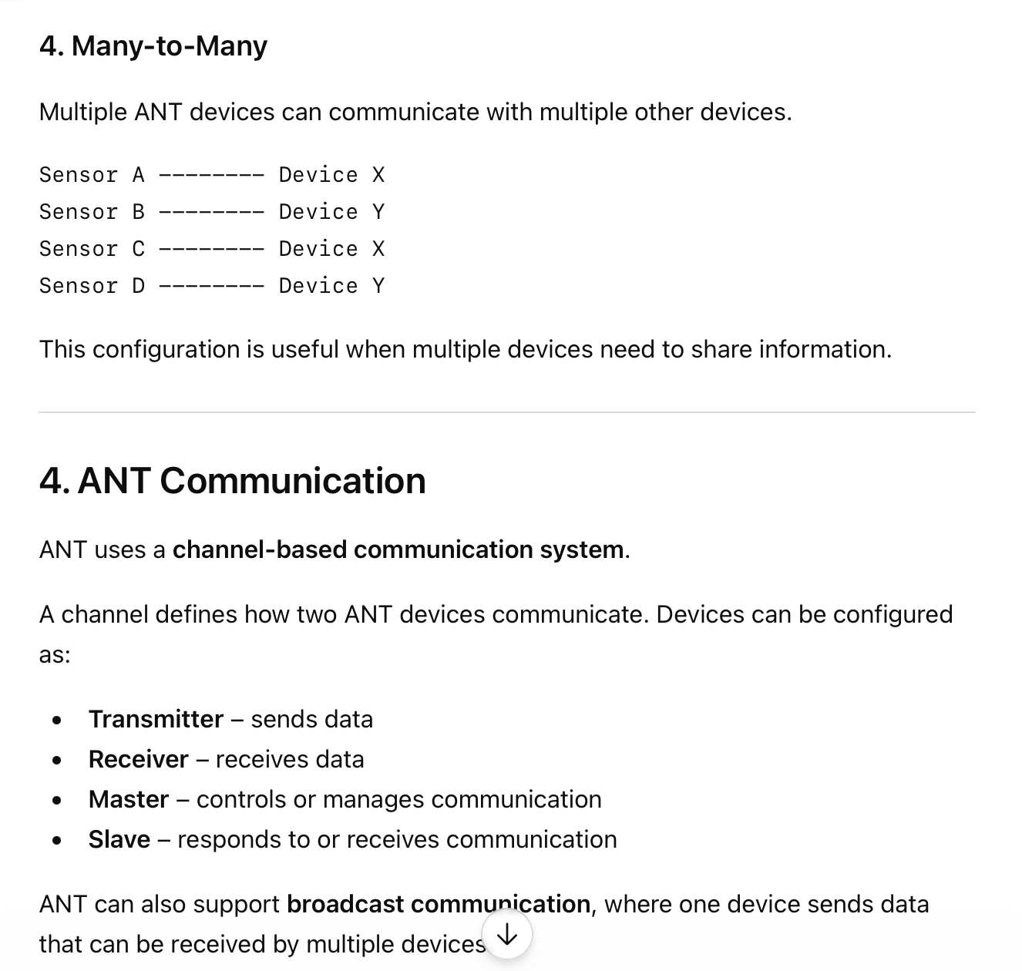
ANT Topology

Slide 24
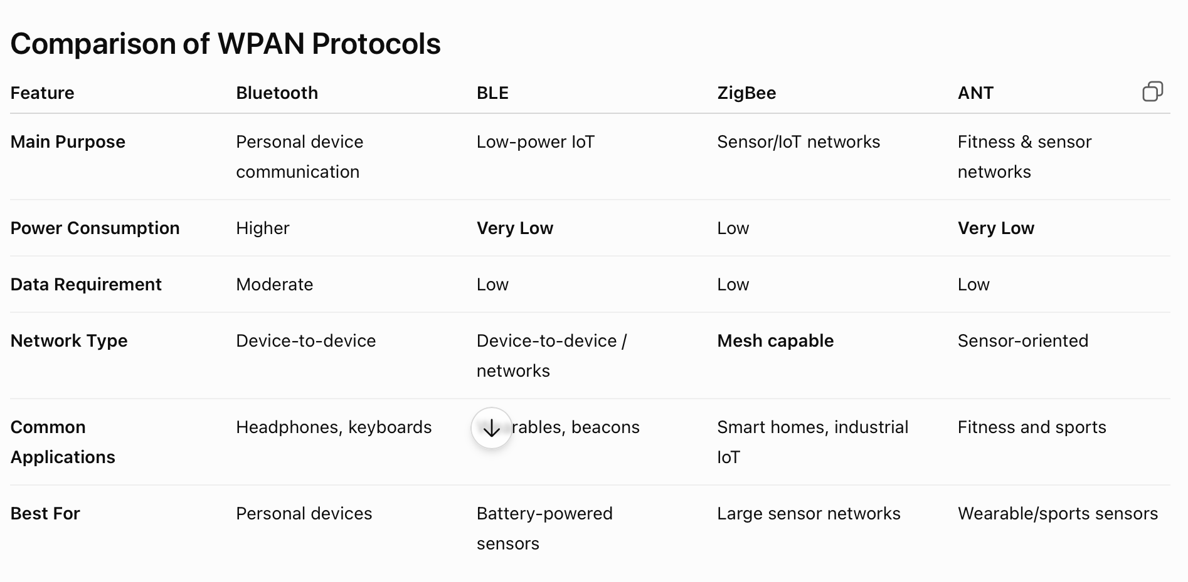

Slide 25
Thank You
Vraj Suratwala
Department of ICT, VNSGU

